Slide 1
Modelleren en Systeemontwerp
Analysis and UML

Slide 2
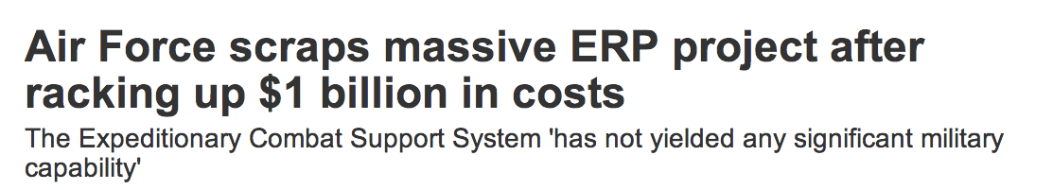
Fill in the blanks…
ERP stands for Enterprise Resource Planning - think of software to manage accounting, HR, etc. (source: http://www.computerworld.com.au)

Slide 3
Disaster tourism
We estimate it would require an additional $1.1B for about a quarter of the original scope to continue and fielding would not be until 2020. The Air Force has concluded the ECSS program is no longer a viable option… Therefore, we are cancelling the program and moving forward with other options…
An Air Force spokesman

Slide 4
Disaster tourism
The system dates back to 2005, when Oracle won an $88.5 million software contract, securing the deal over rival SAP and other vendors. It was supposed to replace more than 200 legacy systems.

Slide 5
Disaster tourism
“This situation raises more questions than answers,” Krigsman said. “Why did it take the [Air Force] $1 billion and almost 10 years to realize this project is a disaster? What kind of planning process accepts a billion dollars of waste?”
Michael Krigsman, expert on IT project failures

Slide 6
Disaster tourism
Of course, this is only a problem for really large organizations, like the US Airforce, right?

Slide 7
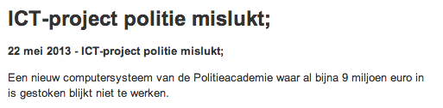
Disaster tourism

Slide 8

Disaster tourism

Slide 9
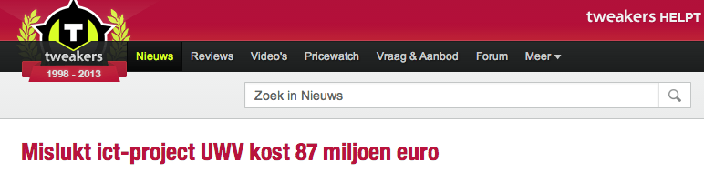
Disaster tourism

Slide 10
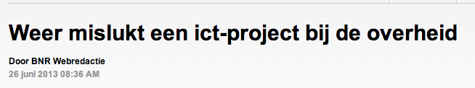
Disaster tourism

Slide 11
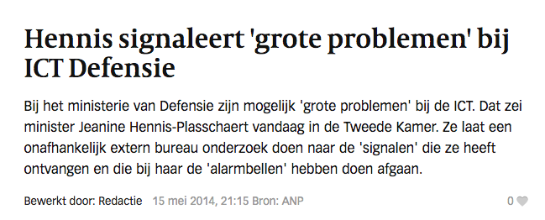
Disaster tourism

Slide 12
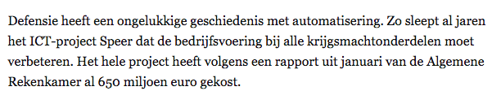
Disaster tourism

Slide 13
This lecture
How can we use our requirements and use cases to analyze and design software?
What notation can we use to describe complex systems concisely?

Slide 14
Analysis
The aim of analysis is to come up with an abstract model of the problem domain
You want to try and transfer requirements and use cases (written with the customer) to a technical specification (written for developers)
A good model simplifies reality, but represents all relevant data

Slide 15

Model: Example

Slide 16
Why model software?
Software is too complex to oversee all the details at once: we need abstractions!
Windows 8 has about 50 million lines of code
The Linux kernel has about 15 million lines of code
Code is written for a machine to execute - not necessarily for a human to understand

Slide 17
Modeling software?
But how can we model software?

Slide 18
The unified modeling language
The UML is a single language with 14(!) different ‘dialects’:
use case diagrams
activity diagrams
class diagrams
sequence diagrams
and several others
It is the de facto standard way for designers, developers, business analysts, and any other technical stakeholders to communicate

Slide 19
UML: Unified modeling language
Before describing the process of analysis further, we need to describe the UML notation in more detail

Slide 20
UML: Activity diagrams
Activity diagrams are useful to describe existing business processes. This can help to validate that you and your customer agree on how the current business work.

Slide 21
UML: Activity diagrams

Slide 22
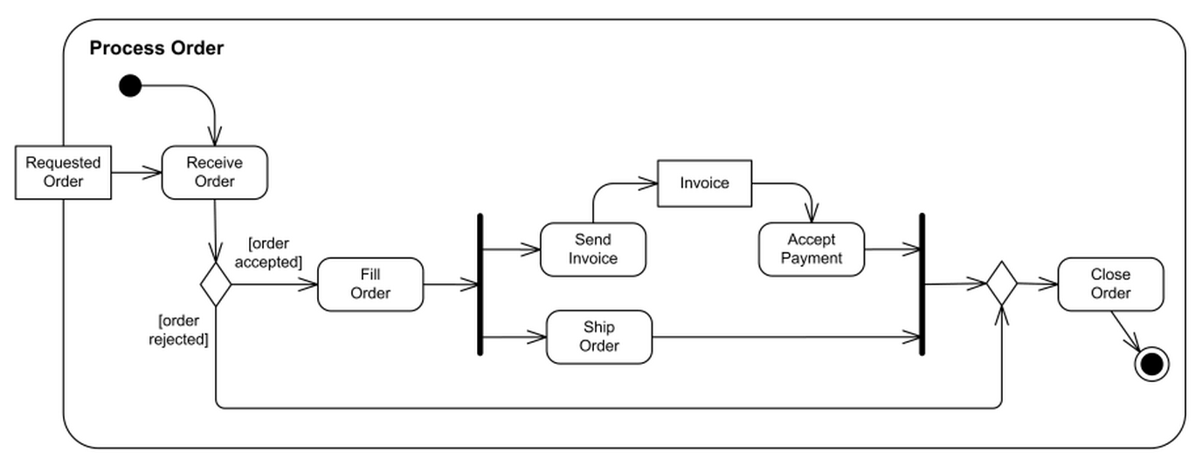
UML: Activity diagrams example

Slide 23
UML: Activity diagrams
Activity diagrams are particularly useful during the Business Modeling phase of the UP - where you establish how the current business processes work
UML is not only about software development!

Slide 24
UML: Class diagrams
One of the most common UML diagrams is the class diagram, used to give a high-level overview of the software system
A class diagram consists of:
boxes to represent classes (together with their attributes and methods)
various arrows to describe the relation between classes
These diagrams are drawn at a varying level of detail, depending on the situation

Slide 25
UML: class diagrams
public class Square
{
public double length;
public void display() {
// code for display
}
}

Slide 26
UML: class diagrams
Use modifiers to indicate the visibility of methods and attributes:
+ indicates a method or attribute is public
- indicates a method or attribute is private
# indicates a method or attribute is protected
There are further modifiers for packages, static methods, etc. Further details can be found in the UML documentation linked from the website

Slide 27
Different levels of detail
Choose the right level of detail, for the right situation:
Early sketches: just use class name
Full design: complete overview of attributes and methods
Goal: communicate unambiguously with developers

Slide 28
Abstract classes
Write the class name in italic to define that class abstract

Slide 29
Relations between objects
The objects A and B are connected ‘somehow.’
Can we be more specific?

Slide 30
Specific relations between objects

Slide 31
Inheritance
Pronounced:
B is a subclass of A
B is derived from A
A is the superclass of B

Slide 32
Inheritance (example)
public class B : A
{
// Class implementation goes here
}

Slide 33
Inheritance (example)

Slide 34
Aggregation and association
Read:
A has a B
B is a part of A

Slide 35
Aggregation and association
public class A
{
public B myB;
}

Slide 36
Aggregation or attribute?
Typically you should use:
attributes to describe primitive types
aggregation to describe the relation with other classes

Slide 37
Aggregation (example)
Note that:
The Aircraft class is kept abstract;
Jets and Helicopters are subclasses of Aircraft.
A picture is worth a thousand words

Slide 38
UML this!
abstract class Shape {
private int width;
private int height;
public Color c;
public int area();
}
public class Circle : Shape
...
public class Rectangle : Shape
...

Slide 39
Composition
Composition is a special form of aggregation, where the contained object is a part of the containing object (and has no right to exist by itself or be referenced by other objects).
The distinction is especially important in languages without garbage collection - who is responsible for the clean-up?

Slide 40
Association vs composition
Sketch the classes and its relations for the following cases.
We own a fleet of planes. On of the plane types is the Boeing 737. Each 737 has a left engine and a right engine. Each plane and each engine have known identities (and a maintenance record).
Our catalog has a collection of racing bikes (for instance X-LITE CRS-3000). Each racing bike has a rear derailleur (for instance Ultegra 6800).

Slide 41
Dependency
Read:
B depends on A
B uses A

Slide 42
Dependency compared to aggregation
The definition of aggregation is unambiguous, dependency is more subtle
Typically dependency is used when there is some relation between two objects, but not this is not an aggregation relation, for example:
Objects of class B create objects of type A
Methods in class B take arguments of type A
Or the class B calls static methods of the class A
More generally, if a change to class A could affect class B, then B depends on A
A good design minimizes dependencies

Slide 43
Directed associations
These pictures correspond to the following three situations:
A person knows the company for which he works
A company knows its employees
Both person and company know about each other

Slide 44
Cardinalities
You may associate a number or range with any association, e.g.
Every A has 0 or 1 objects of type B
Every B has 3 objects of type A
Other examples:
A car has four wheels
You may borrow at most six books from the library

Slide 45
Labeled associations
Sometimes you may want to label an association:

Slide 46
Undirected associations
A relation without arrow is said to be undirected. This can mean two things:
The exact relation is undecided
Both objects know about one another
We will work with the first definition. In the final design, avoid any such ambiguity!

Slide 47
UmL vs code
The UML is a great way to sketch out ideas. You can start very abstractly (just boxes and lines), and flesh out the design as you go along
A fully worked out UML class diagram can be translated to code (with empty method bodies)
Be careful - it is easy to write UML diagrams that cannot be implemented

Slide 48
Problem?
A class may only have one superclass.

Slide 49
Problem?
Library doesn’t give customer a means to access books.

Slide 50
Make necessary information available
A class can only access:
Its own private, public, or protected attributes/methods
The public attributes/methods of other classes it has (aggregation)
The protected and public attributes/methods of its superclasses

Slide 51
Writing precise designs
A design written using the UML is more than just a pretty picture - it needs to be implemented using code
Compiler may provide some sanity check that a program will execute. When you write a design, there is no compiler to check that your design makes sense.
Convince yourself:
check for common errors
replay use cases in your design
write explicit sequence diagrams and check that they are in accordance with the design

Slide 52
Sequence diagrams
A class diagram captures the static structure of your system (which classes are related how?) but does not say anything about the dynamic behavior (what happens when the code is run?)
A sequence diagram is another UML diagram that captures the dynamic control flow of your program

Slide 53
Sequence diagrams
A sequence diagram consists of a number of columns, representing objects
Horizontal arrows between objects represent method calls and returns
Boxes indicate an objects lifetime - from creation to destruction
Time flows downwards

Slide 54
Sequence diagrams (example)

Slide 55
Sequence diagrams (example)

Slide 56
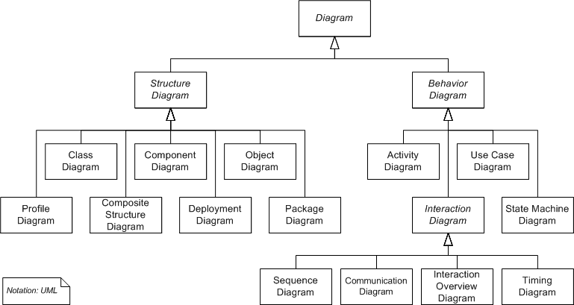
UML
There are many other flavors of the UML for modeling both static structure and dynamic behavior of code.

Slide 57
Analysis and design
Suppose you have talked to all the stakeholders. . .
and written various use cases. . .
and agreed upon a set of requirements. . .
How do I make a great design?

Slide 58
Bridging the gap
A requirements document:
is written in English
should be understood by the customer
aims to establish the system requirements
A design:
is written using UML (class) diagrams
should be understood by developers
aims to communicate how to implement the system

Slide 59
Analysis
Before fixing the design (or drawing UML class diagrams), it can be useful to define a domain model:
specific to the problem domain
captures users' point of view
semi-formal notation - light-weight UML class diagrams without methods
models the real world and not software components
is very similar to Entity-Relationship Modeling

Slide 60
Domain model (Example)

Slide 61
Why write domain models?
Domain models help you to understand the entities a customer works with, and your software system will handle
They help establish a common language with your customer
They provide a visual dictionary describing the relevant concepts in your domain
They are a first step towards defining the software system
They are a first step towards designing a database scheme, if relevant

Slide 62
Analysis: how to write a domain model?
Talk to domain experts
Identify existing solutions/components
Identify design patterns (second half of this course)
Textual analysis

Slide 63
Textual analysis
Once you start writing requirements and use cases, you quickly accumulate a lot of text
Try to use this text to identify parts of the domain:
Nouns are good candidates for conceptual classes
Verbs are good candidates for associations

Slide 64
Textual analysis (from Larman 2002)
Customer arrives at checkout with goods to purchase
Cashier starts a new sale
Cashier records item description, price, and running total for each item
System computes sales total, including tax
Cashier informs Customer of the total and processes payment
System logs completed sale, sends payment info to Accounting and Inventory departments
System prints a receipt
Happy Customer leaves with receipt and goods

Slide 65
Textual analysis: nouns
Customer arrives at checkout with goods to purchase
Cashier starts a new sale
Cashier records item description, price, and running total for each item
System computes sales total, including tax
Cashier informs Customer of the total and processes payment
System logs completed sale, sends payment info to Accounting and Inventory departments
System prints a receipt
Happy Customer leaves with receipt and goods

Slide 66
Selecting potential classes
Customer, Checkout, System, Receipt: should these be objects or not?
What about Price, Total, Description? Are these objects or attributes?
Are Items and Goods two words for the same concept?

Slide 67
Textual analysis: verbs
Customer arrives at checkout with goods to purchase
Cashier starts a new sale
Cashier records item description, price, and running total for each item
System computes sales total, including tax
Cashier informs Customer of the total and processes payment
System logs completed sale, sends payment info to Accounting and Inventory departments
System prints a receipt
Happy Customer leaves with receipt and goods

Slide 68
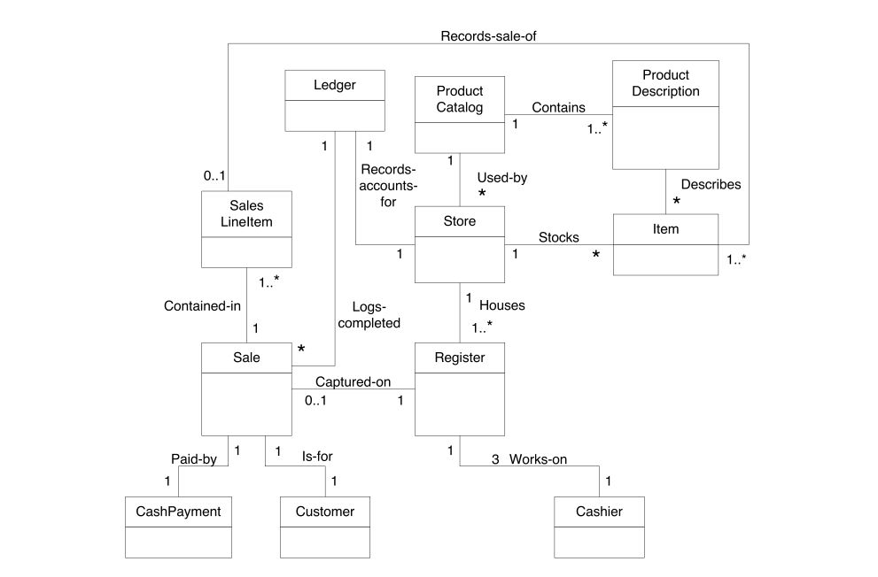
Example (from Larman, Ch 11)

Slide 69
A few common pitfall in domain modeling

Slide 70
But a cash register might be related to other objects. . .

Slide 71
Tip: keep the attribute types simple

Slide 73
Tip: favor associations over keys

Slide 74
The noun-verb analysis
The idea is very simple and easy to execute, but:
Natural language is very imprecise
Many more nouns than relevant classes (more than one name for the same concept)
The design is determined by your use cases - but these two documents serve very different purposes
Don't be afraid to rephrase your use cases!

Slide 75
Case study: elevators
The elevator has one button for each floor
Light up when pressed
Requests that the elevator stops at that floor
The button’s light is turned off once the elevator has stopped at the corresponding floor
Each floor has two buttons to request the elevator to go up or down (except the first floor and top floor, which only have one):
Light up when pressed
Requests that the elevator stops at that floor
The button’s light is turned off once the elevator has arrived at the floor.
(Taken from Peter Muller’s course on Software Engineering)

Slide 76
Use case: fetch elevator
Main success scenario:
Passenger pushes button in the hall
System lights up button
System closes elevator doors
System moves elevator to requested floor
System turns off button’s light
System opens elevator doors

Slide 77
Use case: ride elevator
Main success scenario:
Passenger pushes elevator button
System lights up button
System closes elevator doors
System moves elevator to requested floor
System turns off button’s light
System opens elevator doors

Slide 78
Questions
Can you come up with a domain model?
What sequence diagrams correspond to these use cases?

Slide 79
Validation
After developing your domain model, you still need to validate it:
Correctness: Does it accurately model reality?
Completeness: Is every scenario (including the exceptional cases) described?
Consistency: Does the model contradict itself?
Unambiguous: Does the model describe one reality (and not many)?
Realistic: Can the model be implemented?

Slide 80
How to validate?
You may use diagrams with different purposes (use cases, classes, sequence diagrams, etc.) to describe the same system.
Do all these diagrams agree?
Take care of homonyms and synonyms
Is every class described exactly once?
No dangling associations?

Slide 81
Material covered
Design Patterns explained: chapter 2
Applying UML and patterns: chapter 10-13 and chapter 15

